Slide 1
Verification in BCNs
Use MCMAS

Slide 2
Contents
Introduction and Motivation
Flow Chart
Details

Slide 3
Introduction and Motivation
Background
Introduction of BNs
Introduction of BCNs
Motivation
Notes:
首先讲解第一部分，包括问题背景，布尔网络的介绍，布尔控制网络的介绍，以及论文的motivation。

Slide 4
Background
In 1960s, Jacob and Monod found that “Any cell contains a number of ‘regulatory’ genes that act as switches and can turn one another on and off.... If genes can turn one another on and off, then you can have genetic circuits.” Based on these Boolean-type actions in genetic circuits, Kauffman proposed using the Boolean network to describe the genetic circuits .
Notes:
在20世纪60年代，雅各布和莫诺德发现：“任何细胞都含有许多‘调控’基因，它们起着开关的作用，可以互相打开或关闭......如果基因可以互相影响彼此的打开和关闭，这种关系可以组成基因线路“。基于基因线路中的这些布尔型相互作用，考夫曼提出用布尔网络来描述基因线路。

Slide 5
Introductions of BNs
A Boolean network is a network with nodes and directed edges, denoted by(N, ε), where N is a finite set of nodes and ε ⊂ N×N is the edge set. A node can take a logic value from {0, 1} at a discrete time 0, 1, 2... Assume that A, B ∈ N and (A, B) ∈ ε, then it means that in the network dynamics B(k+1) depends on A(k).
Notes:
ε epsilon。首先介绍一下布尔网络，在布尔网络中具有节点和有向边。可用一个二元组N和ε epsilon来表示，N代表网络中节点的集合，ε epsilon代表节点之间的有向边。布尔网络上的每个节点将包含一个逻辑值，取0或者1，并且在不同时间节点上，这个取值可能不同。如果A，B是布尔网络上的节点，并且存在有向边由A指向B，那么我们可以知道，B在下一个时间点的取值将受到A当前时间点取值的影响。

Slide 6
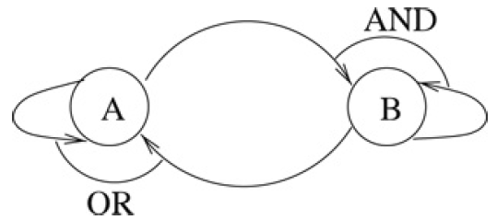
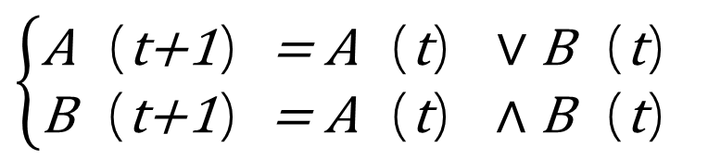
Introductions of BNs
We give a simple example to describe it.
Example 1. In Fig.1 we have a Boolean network with two nodes A and B. Its dynamics is described as
$$\left\{\begin{matrix}\text{A}（\text{t}\text{+1}）\text{=} \text{A}（\text{t}）∨\text{B}（\text{t}） \\ \text{B}（\text{t}\text{+1}）\text{=} \text{A}（\text{t}）∧\text{B}（\text{t}）\end{matrix}\right.$$
Fig.1
Notes:
举一个直观的例子来做说明，在这个布尔网络当中有两个节点A和B，A的下一个时间点的取值受到A跟B当前时间点取值的影响。满足入公式所示的关系。那么，什么是布尔控制网络呢，将布尔网络当中的节点看做状态节点，并加上输入跟输出节点，便能够得到布尔控制网络。

Slide 7
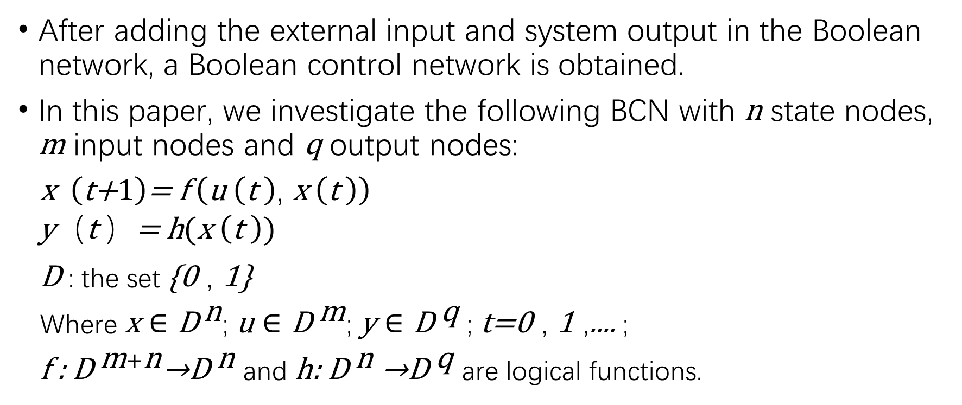
Introductions of BCNs
After adding the external input and system output in the Boolean network, a Boolean control network is obtained.
In this paper, we investigate the following BCN with n state nodes, m input nodes and q output nodes:
$\text{x} （\text{t}\text{+}1）\text{=} \text{f} （\text{u} （\text{t} ）\text{,} \text{x} （\text{t} ））$
$$\text{y}（\text{t} ）\text{=} \text{h}(\text{x} \left(\text{t} \right))$$
D : the set {0 , 1}
Where $\text{x}∈{\text{D}}^{ \text{n}}$; $\text{u}∈{\text{D}}^{ \text{m}}$; $\text{y}∈{\text{D}}^{ \text{q}}$ ; t=0 , 1 ,.... ;
f : ${\text{D}}^{ \text{m}+\text{n}}$→${\text{D}}^{ \text{n}}$ and h: ${\text{D}}^{ \text{n}}$→${\text{D}}^{ \text{q}}$ are logical functions.
Notes:
我们假设布尔控制网络有n个状态节点，m个输入节点，q个输出节点。并且，状态节点的下一个时间点的取值受到当前时间点下状态节点和输入节点的取值的影响。输出节点的取值受到当前时间点下状态节点的取值的影响。则可用这样的式子来表征，他们之间的关系。

Slide 8






Introductions of BCNs
Example2 . In Fig.2
State nodes A and B belong to
Input node D belongs to
Output node C belongs to
A
$$\text{x}∈{\text{D}}^{ 2}$$
$$\text{u}∈{\text{D}}^{ 1}$$
$$\text{y}∈{\text{D}}^{ 1}$$
D
C
$$\text{C} (\text{t} )\text{=}\vec{\text{A} \left(\text{t} \right)∨\text{B} (\text{t} )}$$
$$\text{A} (\text{t}\text{+1})\text{=}\text{A} (\text{t})∨\vec{B\left(\text{t} \right)}∨D(\text{t} )$$
B
$$\text{B} (\text{t}\text{+1} )\text{=}(\text{A}\left(\text{t} \right)∨\vec{B\left(\text{t} \right)}∨D\left(\text{t} \right))∧$$
$$(\text{A}(\text{t} )∨\vec{B\left(\text{t} \right)}∨\vec{D\left(\text{t} \right)}）∧(\vec{A\left(\text{t} \right)}∨\text{B}(\text{t} )∨\vec{D\left(\text{t}\right)} )$$
Fig.2
Notes:
如这个例子所示，在这个布尔控制网络中包含两个状态节点A，B，一个输入节点D，一个输出节点C。输入节点C受到两个状态节点的影响，状态节点A，B下一个时间点对应的值受到当前时间点下两个状态节点和输入节点的值得影响。

Slide 9
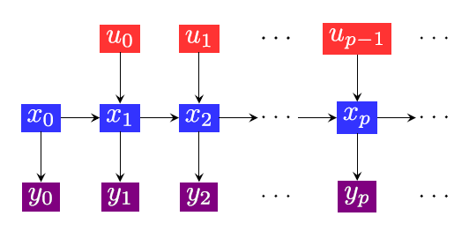
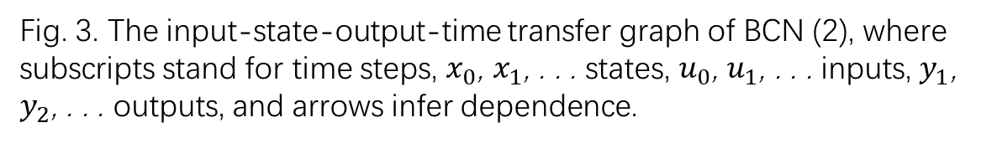
Introductions of BCNs
The input-state-output-time transfer graph of BCN is drawn in
Fig. 3.
Fig. 3. The input-state-output-time transfer graph of BCN (2), where subscripts stand for time steps, $x_{0}$, $x_{1}$, . . . states, $u_{0}$, $u_{1}$, . . . inputs, $y_{1}$, $y_{2}$, . . . outputs, and arrows infer dependence.
Notes:
因此，我们可以用输入、状态、输出关系图来表示。首先，我们有起始的状态节点的值，由此可以得到输出节点的值。再由输入节点的值可以得到下一个时间点对应的状态节点的值和输出节点的值。

Slide 10
Motivation
When we consider BCNs, it is important to study the observability of BCNs. And there are four types of observability of BCNs, we want to compare them. So I propose a unified approach to determine all the four types of observability of BCNs in this slide. And by this approach we can use MCMAS to verify the observability of BCNs
Notes:
当我们要使用布尔控制网络的时候，能够分辨并确定它的状态节点的值是极为必要的。我们的思路是通过输出节点的值来得到状态节点的值。但是，在孤立的时间点上，不同的状态节点的值可以对应相同的输出节点的值。那么，我们该怎么办呢。答案是通过输入节点控制状态节点，在观察输出节点来得到我们要的答案。最后能否得到我们要的答案便成为布尔控制网络的可观测性。现今，有四种可观测性，本篇论文将使用一种统一的方法来表征并确定他们。

Slide 11
Flow Chart
Observability of BCNs
Algebraic Forms
Dynamic network
Finite Automata
Model Checking
Notes:
流程如图所示，先阐述四种可观测性。接着，由于之前形式下节点的值与节点之间的关系不便与使用，我们提出布尔控制网络的代数形式，并阐述对应代数形式下四种可观测性，代数形式下的可观测性是已有的不是这篇文章提出的。再使用了代数形式表征了四种可观测性后，再使用带权对图进而使用有限状态自动机来表征并确定他们。接下来我们按流程图来，将细节理清楚。

Slide 12
Details
Observability of BCNs
Algebraic Forms
Dynamic network
Finite Automata
Model Checking
Notes:
细节部分，便是如流程图所体现的那四个部分。

Slide 13
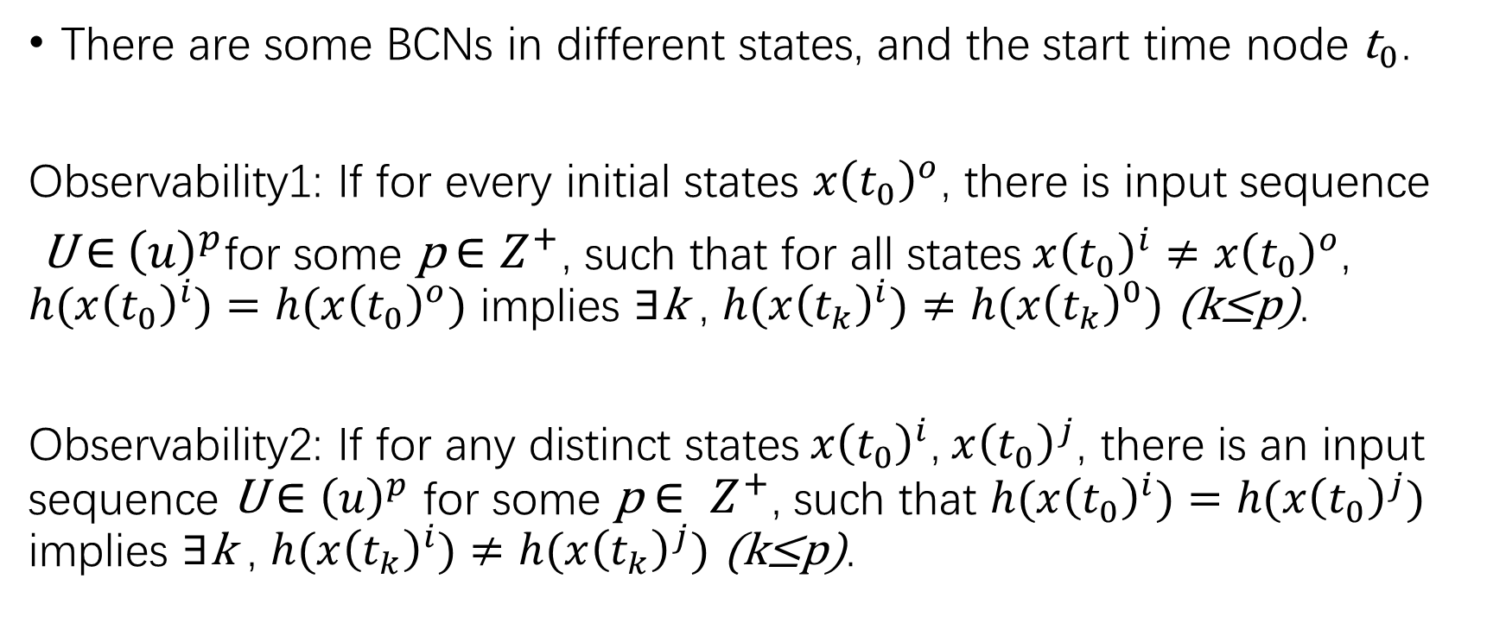
Observability of BCNs
There are some BCNs in different states, and the start time node ${\text{t}}_{0}$.
Observability1: If for every initial states $x{\left(t_{0}\right)}^{o}$, there is input sequence
U$∈$ ${\left(u\right)}^{p}$for some p $∈Z^{+}$, such that for all states$x{\left(t_{0}\right)}^{i}≠x{\left(t_{0}\right)}^{o}$, $h(x{\left(t_{0}\right)}^{i})=h(x{\left(t_{0}\right)}^{o})$ implies $∃$k , $h(x{\left(t_{k}\right)}^{i})≠h(x{\left(t_{k}\right)}^{0})$ (k≤p).
Observability2: If for any distinct states$x{\left(t_{0}\right)}^{i}$,$x{\left(t_{0}\right)}^{j}$, there is an input sequence U $∈$ ${\left(u\right)}^{p}$ for some p $∈ Z^{+}$, such that $h(x{\left(t_{0}\right)}^{i})=h(x{\left(t_{0}\right)}^{j})$ implies $∃$k , $h(x{\left(t_{k}\right)}^{i})≠h(x{\left(t_{k}\right)}^{j})$ (k≤p).
Notes:
第一部分，描述四种可观测性。第一种可观测性，对于任意一种初始状态节点的值$x{\left(t_{0}\right)}^{o}$，我们都可以找到至少一个输入序列来确定它，假设该输入序列的长度为p，并且对于任意另一个初始状态节点$x{\left(t_{0}\right)}^{i}$不等于$x{\left(t_{0}\right)}^{o}$，但是它们对应的输出一致，再对它们都输入这个序列后，产生的输出序列中，至少有一位是不同的。第一种可观测性的重点在于，每一种初始状态都可以跟其他状态区分开来。而第二种可观测性，则着重点在于，任意两个不同的状态都可以区分开来。大家或许会问，这两种可观测性不是一样吗？其实是不一样的，第一种可观测性中使用一个输入序列便可以使得某种初始状态跟其它初始状态区分。但是第二种可观测性中，则可能需要不同的输入序列来分别区分他们。

Slide 14
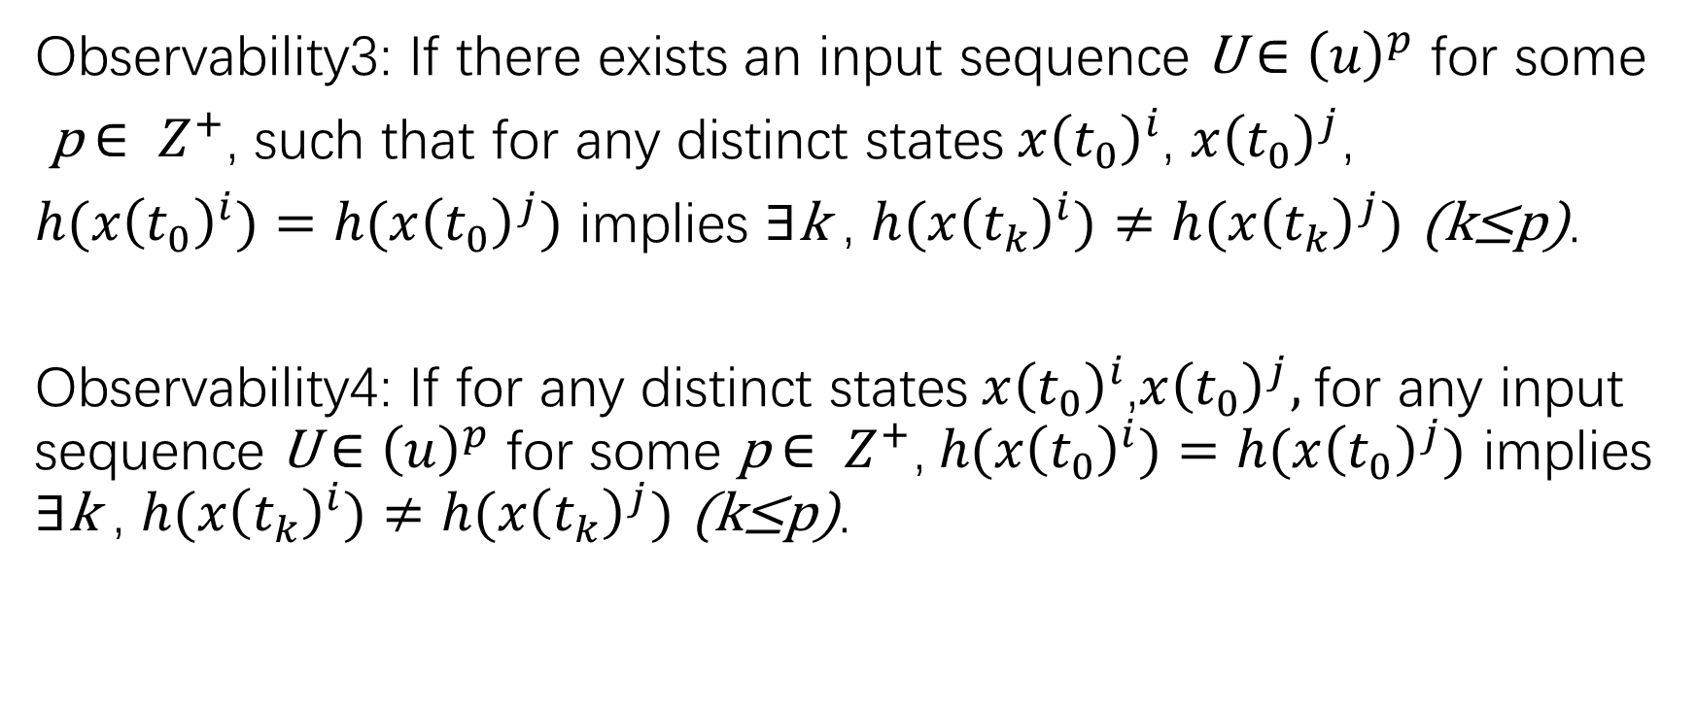
Observability of BCNs
Observability3: If there exists an input sequence U$∈$ ${\left(u\right)}^{p}$ for some
p $∈ Z^{+}$, such that for any distinct states$x{\left(t_{0}\right)}^{i}$, $x{\left(t_{0}\right)}^{j}$,
$h(x{\left(t_{0}\right)}^{i})=h(x{\left(t_{0}\right)}^{j})$ implies $∃$k , $h(x{\left(t_{k}\right)}^{i})≠h(x{\left(t_{k}\right)}^{j})$ (k≤p).
Observability4: If for any distinct states$x{\left(t_{0}\right)}^{i}$,$x{\left(t_{0}\right)}^{j},$for any input sequence U$∈$ ${\left(u\right)}^{p}$ for some p $∈ Z^{+}\text{,} h(x{\left(t_{0}\right)}^{i})=h(x{\left(t_{0}\right)}^{j})$ implies $∃$k , $h(x{\left(t_{k}\right)}^{i})≠h(x{\left(t_{k}\right)}^{j})$ (k≤p).
Notes:
第三种可观测性，则强调，存在这样一个序列，这个序列可以把所有不一样的初始状态区分开来。这里跟之前两种的区别在于，前两种是先考虑某种状态再考虑序列是否存在，因此可以有很多不同的序列。而第三种，则是，这个序列一存在，对于任意不同的初始状态都可以区分开来。接着，第四种可观测性是，先限定长度，当长度足够长的时候，任意的输入序列都可以将不同的初始状态区分开来。

Slide 15
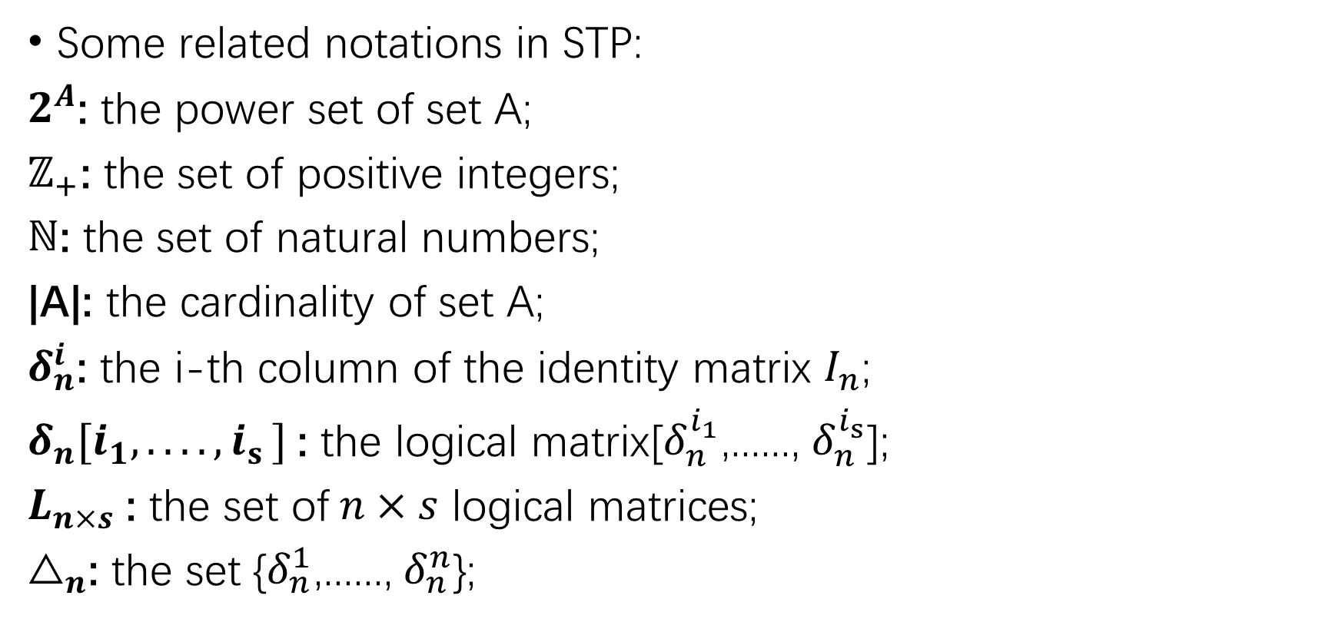
Their Algebraic Forms
Some related notations in STP:
$2^{A}$: the power set of set A;
$ℤ_{+}$: the set of positive integers;
$ℕ$: the set of natural numbers;
|A|: the cardinality of set A;
$δ_{n}^{i}$: the i-th column of the identity matrix $I_{n}$;
$δ_{n}[i_{1},.. .. {,i}_{s}]$: the logical matrix[$δ_{n}^{i_{1}}$,......, $δ_{n}^{i_{s}}$];
$L_{n×s}$: the set of$n×s$ logical matrices;
$△_{n}$: the set {$δ_{n}^{1}$,......, $δ_{n}^{n}$};
Notes:
我们将使用矩阵的半张量积来作为布尔控制网络的代数形式，这些是矩阵半张量积对应的一些基础概念。包括集合的幂集，正整数集合，自然数集合，deta n i表示n阶单位矩阵的第i列，deta n i1 到 is表示由s个deta n i组成的逻辑矩阵。Ln*s表示由逻辑矩阵组成的集合。大deta表示包含n个deta n I 的集合。

Slide 16
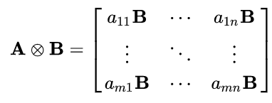
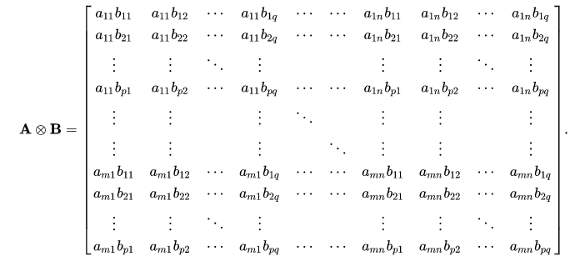
Their Algebraic Forms
Definition of Kronecker Product
If A is an m × n matrix and
B is a p × q matrix, then the
Kronecker product A ⊗ B is
the mp × nq block matrix:
Notes:
在介绍半张量积之前，需要介绍一下克罗尼克积，如果有m*n的矩阵A和p*q的矩阵B，A B的克罗尼克积便是将A中的所有元素乘以矩阵B，便是上面的第一种形式，更具体便是下面这种形式。容易看出，得到的矩阵为mp行nq列。当我们要把两个矩阵乘起来的时候，要满足左边的列数等于右边的行数。

Slide 17
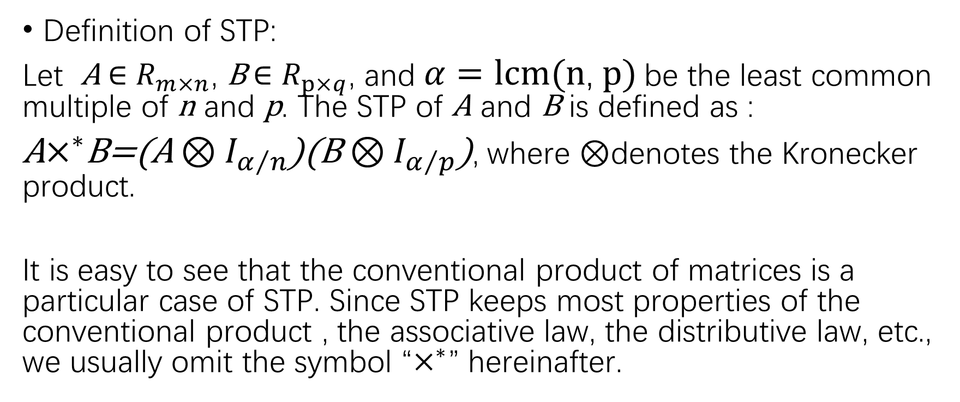
Their Algebraic Forms
Definition of STP:
Let A $∈$ $R_{m×n}$, B $∈$ $R_{p×q}$, and$α=lcm(n\text{,} p)$ be the least common multiple of n and p. The STP of A and B is defined as :
A$×^{∗}$B=(A $⊗I_{α/n}$)(B$⊗I_{α/p}$), where $⊗$denotes the Kronecker product.
It is easy to see that the conventional product of matrices is a particular case of STP. Since STP keeps most properties of the conventional product , the associative law, the distributive law, etc., we usually omit the symbol “$×^{∗}$” hereinafter.
Notes:
首先，令a为n和p的最小公倍数，得到a，矩阵A与B的半张量积便如这个公式所示，根据克罗尼克积的性质，可知公式右边的前半部分所表示的矩阵与后半部分表示的矩阵可以做乘运算。使用半张量积的目的便是令原本没法直接乘的两个矩阵现在可以相乘。

Slide 18
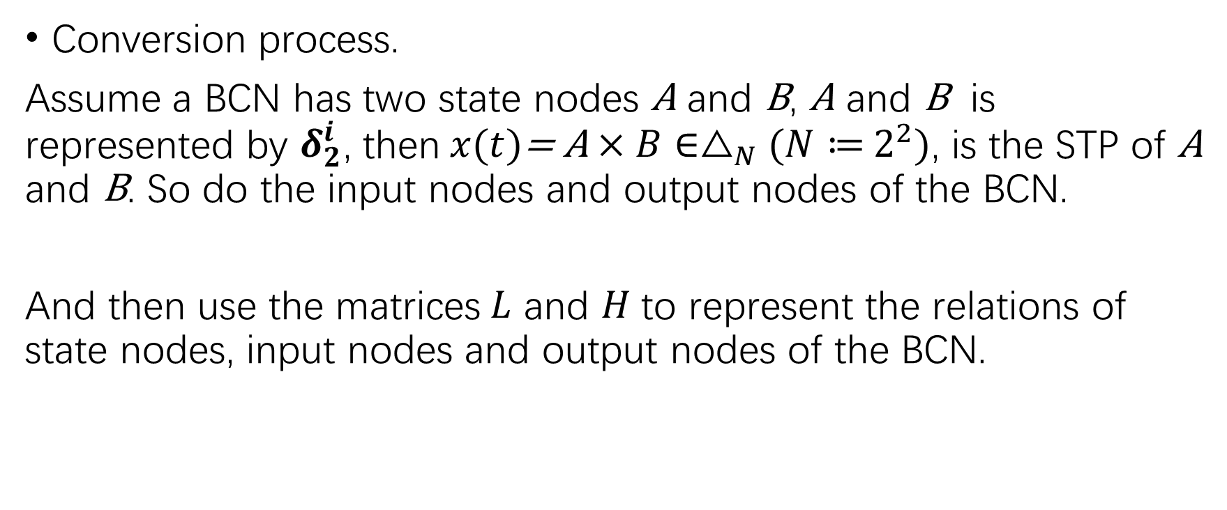
Their Algebraic Forms
Conversion process.
Assume a BCN has two state nodes A and B, A and B is represented by $δ_{2}^{i}$, then$x(t)$= A $×B∈△_{N}(N≔$ $2^{2})\text{,}$ is the STP of A and B. So do the input nodes and output nodes of the BCN.
And then use the matrices$L$ and $H$to represent the relations of state nodes, input nodes and output nodes of the BCN.
Notes:
转换的过程是，例如一个布尔控制网络有两个状态节点A B，用delta21 表示1 delta22表示 0，将A B的取值转换后再按序乘起来，便得到一个向量这个向量便可以表征A 和B的取值。同理输入输出节点也做同样的操作。

Slide 19
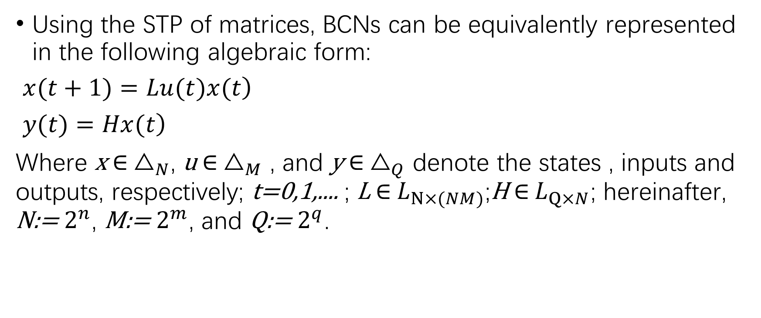
Their Algebraic Forms
Using the STP of matrices, BCNs can be equivalently represented in the following algebraic form:
$\left.x(t+1)=Lu(t)x(t\right)$
$\left.y(t)=Hx(t\right)$
Where x $∈$ $△_{N}$, u $∈$ $△_{M}$ , and y $∈$ $△_{Q}$ denote the states , inputs and outputs, respectively; t=0,1,.... ; L $∈$ $L_{N×(NM)}$;H $∈$ $L_{Q×N}$; hereinafter, N:= $2^{n}$, M:= $2^{m}$, and Q:= $2^{q}$.
Notes:
在布尔控制网络的代数形式中，用向量来表示布尔控制网络的状态节点、输入节点以及输出节点的值。并用矩阵来表示他们之间的关系。通过半张量积的使用，代数形式更容易理解并有利于后续的工作。

Slide 20
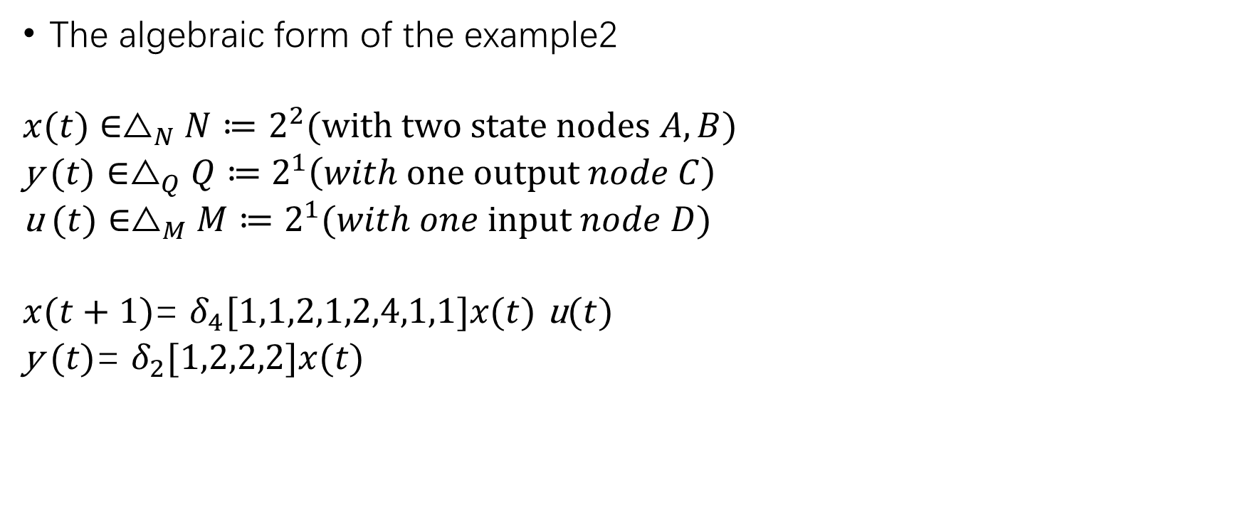
Their Algebraic Forms
The algebraic form of the example2
$x(t)$ $∈△_{N}N≔$ $2^{2}(with two state nodes A,B)$
y$(t)$ $∈△_{Q}Q≔$ $2^{1}\left(with one output node C\right)$
u$(t)$ $∈△_{M}M≔$ $2^{1}(with one input node D)$
$x(t+1)$= $δ_{4}[1,1,2,1,2,4,1,1]x(t)$u$(t)$
y$(t)$= $δ_{2}[1,2,2,2]x(t)$
Notes:
上文提到的布尔控制网络的向量形式便如下所示。节点的值转化成对应的向量，并且转换关系用矩阵表示。

Slide 21
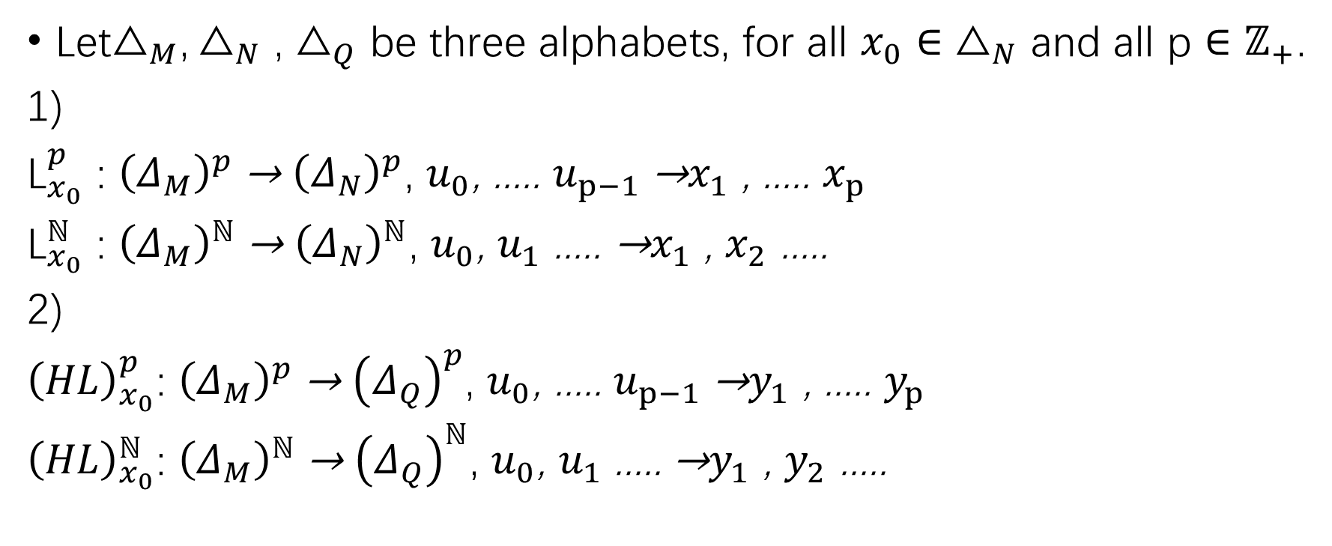
Their Algebraic Forms
Let$△_{M}{\text{,}△}_{N}$ , $△_{Q}$ be three alphabets, for all $x_{0}∈$ $△_{N}$ and all p $∈$ $ℤ_{+}$.
1)
${\text{L}}_{x_{0}}^{p}$ : ${\left(Δ_{M}\right)}^{p}$ → ${\left(Δ_{N}\right)}^{p}$, $u_{0}$, ..... $u_{p−1}$ →$x_{1}$ , ..... $x_{p}$
${\text{L}}_{x_{0}}^{ℕ}$ : ${\left(Δ_{M}\right)}^{ℕ}$ → ${\left(Δ_{N}\right)}^{ℕ}$, $u_{0}$, $u_{1}$ ..... →$x_{1}$ , $x_{2}$ .....
2)
${\left(HL\right)}_{x_{0}}^{p}$: ${\left(Δ_{M}\right)}^{p}$ → ${\left(Δ_{Q}\right)}^{p}$, $u_{0}$, ..... $u_{p−1}$ →$y_{1}$ , ..... $y_{p}$
${\left(HL\right)}_{x_{0}}^{ℕ}$: ${\left(Δ_{M}\right)}^{ℕ}$ → ${\left(Δ_{Q}\right)}^{ℕ}$, $u_{0}$, $u_{1}$ ..... →$y_{1}$ , $y_{2}$ .....
Notes:
为了更好的理解可观测性，我们规定 L x0 p作为初始状态为x0，对应长度为p输入序列到长度为p状态序列的映射，HLx0p作为p输入序列到长度为p输出序列的映射。同理可将p推广到正无穷。

Slide 22
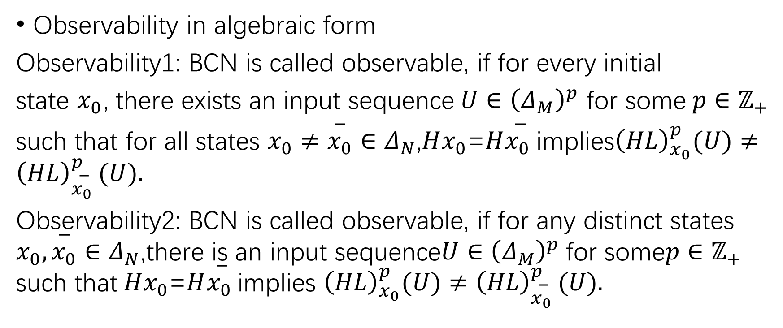
Their Algebraic Forms
Observability in algebraic form
Observability1: BCN is called observable, if for every initial
state $x_{0}$, there exists an input sequence$U∈{\left(Δ_{M}\right)}^{p}$ for some$p∈ℤ_{+}$
such that for all states $x_{0}≠\overset{−}{x_{0}}∈Δ_{N}$,$Hx_{0}$=$H\overset{−}{x_{0} }$implies${\left(HL\right)}_{x_{0}}^{p}(U)≠{\left(HL\right)}_{\overset{−}{x_{0} }}^{p}(U).$
Observability2: BCN is called observable, if for any distinct states $x_{0},\overset{−}{x_{0}}∈Δ_{N}$,there is an input sequence$U∈{\left(Δ_{M}\right)}^{p}$for some$p∈ℤ_{+}$ such that$Hx_{0}$=$H\overset{−}{x_{0} }$implies ${\left(HL\right)}_{x_{0}}^{p}(U)≠{\left(HL\right)}_{\overset{−}{x_{0} }}^{p}(U).$
Notes:
我们通过对比产生的序列来判定是否满足可观测。

Slide 23
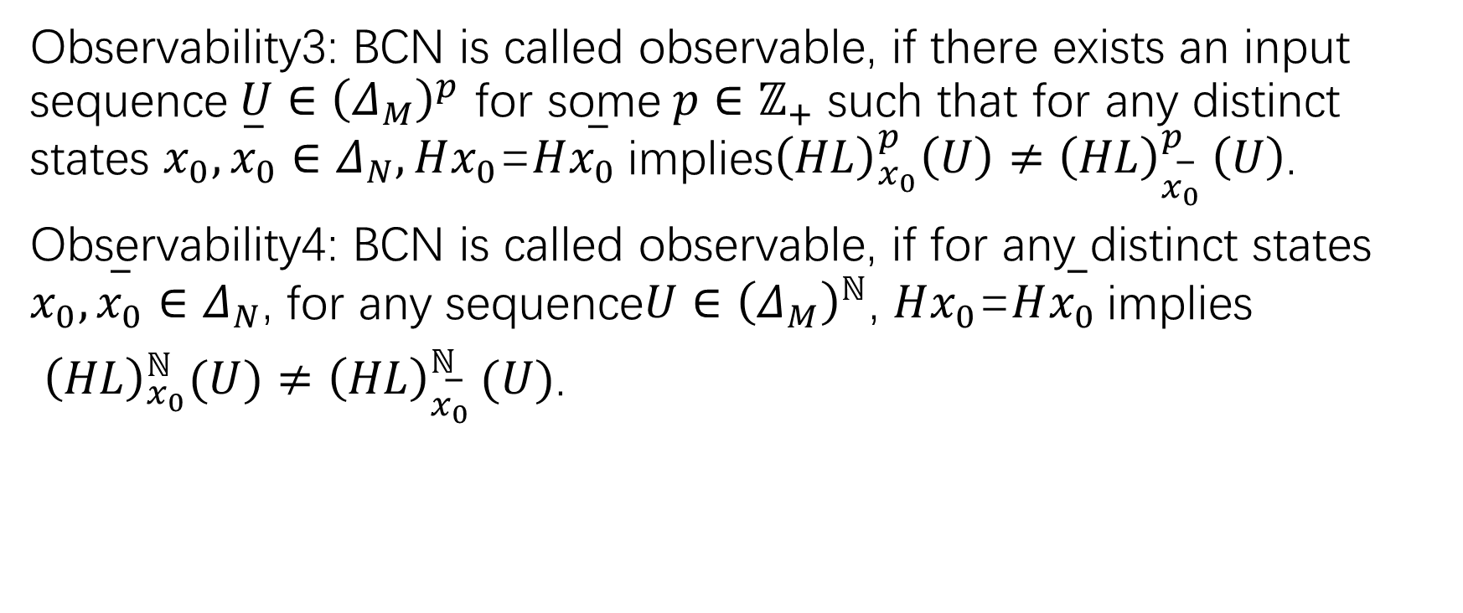
Their Algebraic Forms
Observability3: BCN is called observable, if there exists an input sequence$U∈{\left(Δ_{M}\right)}^{p}$ for some$p∈ℤ_{+}$ such that for any distinct states $x_{0},\overset{−}{x_{0}}∈Δ_{N},Hx_{0}$=$H\overset{−}{x_{0} }$implies${\left(HL\right)}_{x_{0}}^{p}\left(U\right)≠{\left(HL\right)}_{\overset{−}{x_{0} }}^{p}\left(U\right)$.
Observability4: BCN is called observable, if for any distinct states $x_{0},\overset{−}{x_{0}}∈Δ_{N}$, for any sequence$U∈{\left(Δ_{M}\right)}^{ℕ}$, $Hx_{0}$=$H\overset{−}{x_{0} }$implies
${\left(HL\right)}_{x_{0}}^{ℕ}(U)≠{\left(HL\right)}_{\overset{−}{x_{0} }}^{ℕ}(U)$.

Slide 24
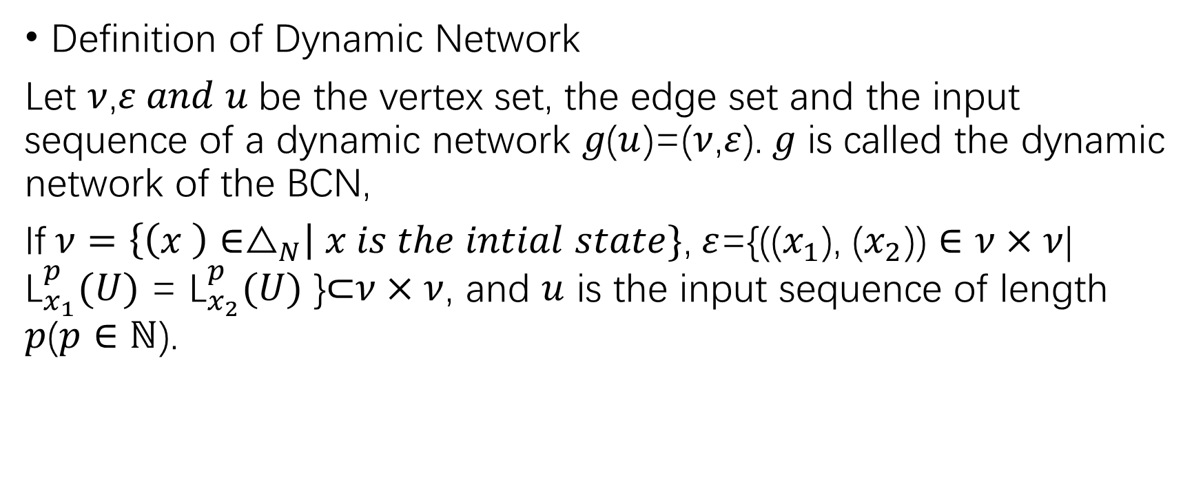
Dynamic Network
Definition of Dynamic Network
Let $ν$,$ε and u$be the vertex set, the edge set and the input sequence of a dynamic network $g\text{(}u$)=($ν$,$ε$).$g$ is called the dynamic network of the BCN,
If$ν=\left\{\left(x \right)∈△_{N}\right| x is the intial state\}$,$ε$={(($x_{1}$), ($x_{2}$)) $∈ν×ν$| ${\text{L}}_{x_{1}}^{p}(U)$ = ${\text{L}}_{x_{2}}^{p}(U)$ }⊂$ν×ν$, and $u$ is the input sequence of length $p$($p∈ℕ$).

Slide 25
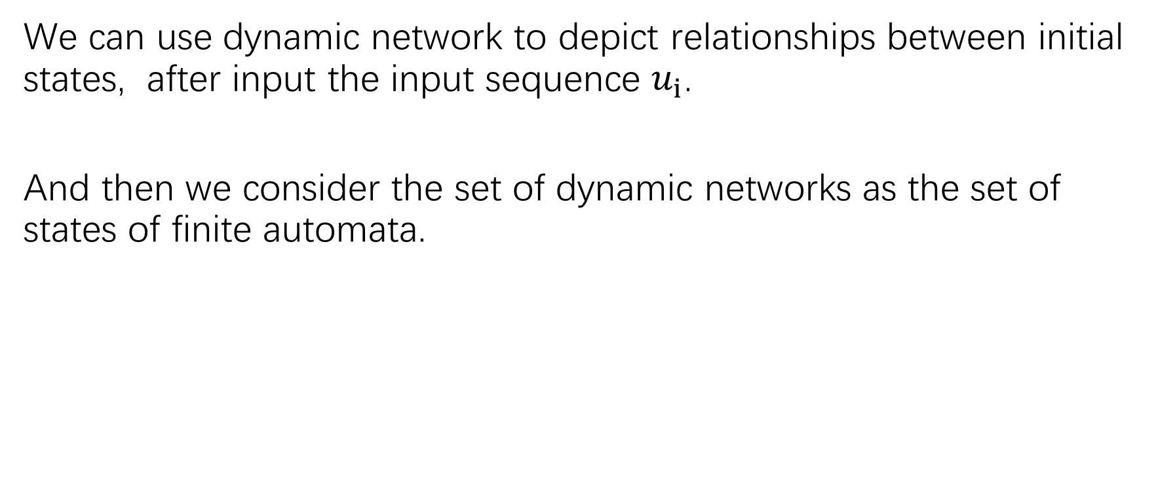
Dynamic Network
We can use dynamic network to depict relationships between initial states, after input the input sequence $u_{i}$.
And then we consider the set of dynamic networks as the set of states of finite automata.

Slide 26
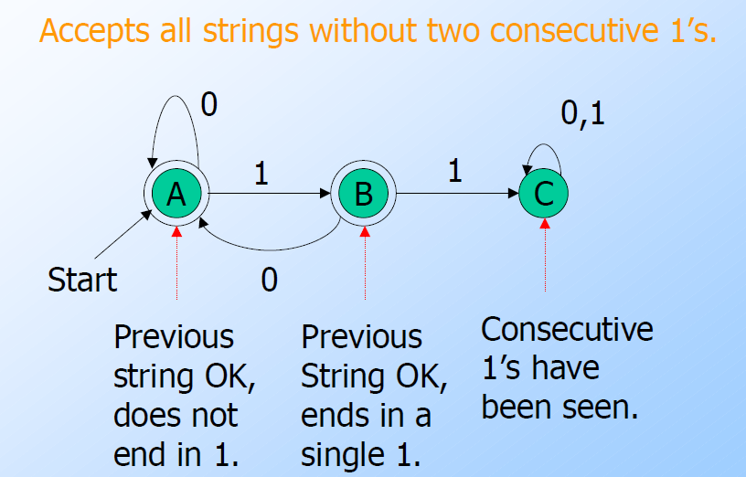
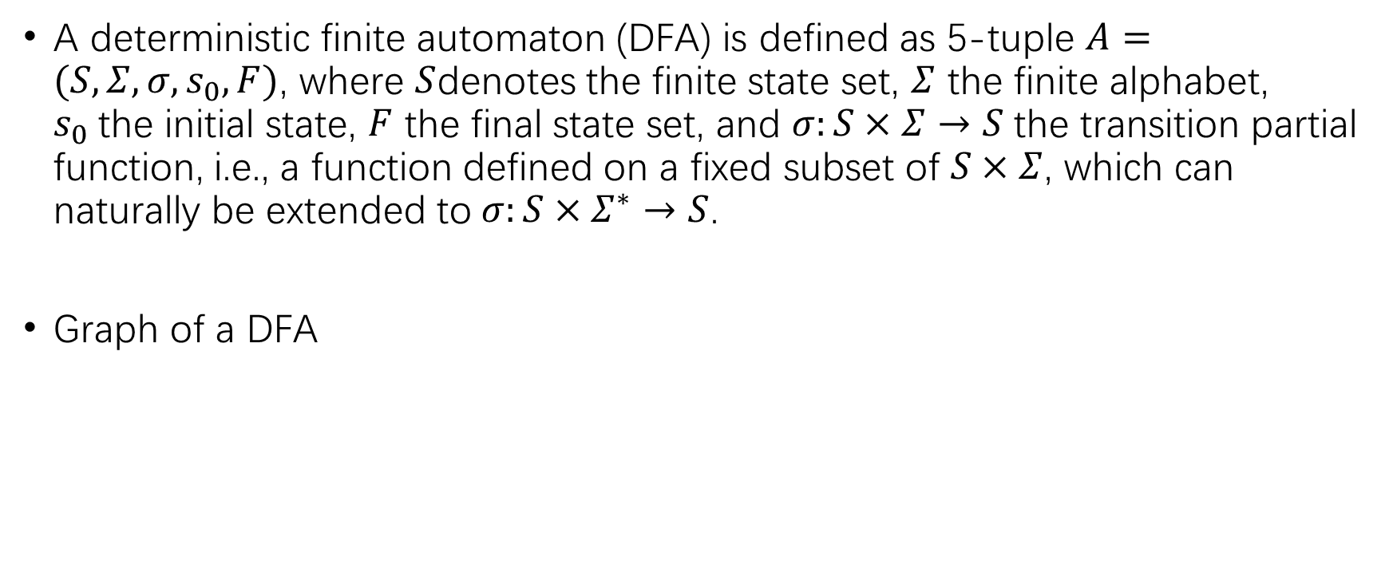
Finite Automata
A deterministic finite automaton (DFA) is defined as 5-tuple $A=(S,Σ,σ,s_{0},F)$, where $S$denotes the finite state set, $Σ$ the finite alphabet, $s_{0}$the initial state, $F$ the final state set, and $σ:S×Σ→S$the transition partial function, i.e., a function defined on a fixed subset of $S×Σ$, which can naturally be extended to$σ:S×Σ^{∗}→S$.
Graph of a DFA
Notes:
∑： sigma 大小，下一步是根据四种可观测性来构造自动机，自动机可用一个五元组来表示。

Slide 27

Finite Automata
$$u$$

